Slide 1
Filtration, Safety, Research

Slide 2
Filtration Experiment
Why was the head loss so great?
Why didn’t the orifice work and how could we make it work the next time?
Why was it difficult to control the flow rate?
How might you improve the design?

Slide 3
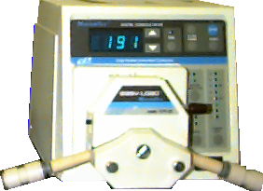
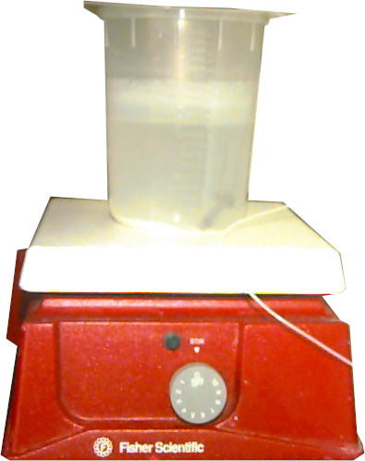
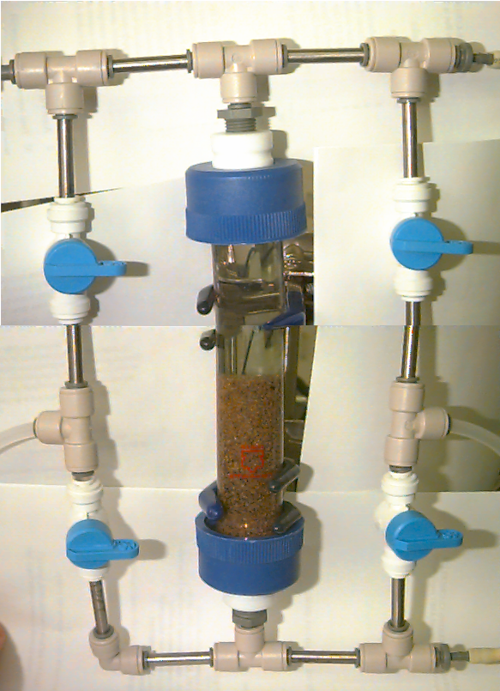
Improve the design?
Raw Water

Slide 4
Filtration Write-up
Write a brief summary (1 page) of what you learned by doing this experiment.

Slide 5
Research Project
Begin research next week
Submit materials and methods on Monday so I can order any special supplies that you need
How big should your research project be?
  Minimum of 2 weeks of labs
Document what you do!

Slide 6
Lab Access
You now have access to the Environmental Laboratory
Avoid working along in a laboratory
  Buddy system required outside of normal business hours
Professional Conduct
Don’t forget personal protection
  Safety glasses
  Lab coat
  Long pants
  Closed shoes

Slide 7
A Few Safety Rules
   
Think through each step before beginning an experiment
Identify possible hazards and take appropriate measures to contain or minimize hazards (read labels)
If you don’t know what is going to happen and think there may be a potential for danger
  Stop!
  Get help before proceeding or modify procedure to minimize risk.
When using hazardous chemicals use secondary containment and appropriate personal protection

Slide 8
More Safety guidelines
Label all containers!
Unattended operation
  Consider worst case scenario failure
  Provide secondary containment if appropriate
  Obtain permission

Slide 9
Routes of Chemical Exposure
skin
  protective clothing
  gloves
ingestion
  don’t pipette by mouth!
  no food in the lab
  wash before leaving the lab
inhalation
  dust and vapors (use fume hood when either are present)
eyes
  eye protection against splashing and vapors
Notes:
mention chronic vs. acute exposure

